Slide 1
Exoplanet Detection
and finding Jupiter-like planets around Sun-like stars
Kevin Hoy, Joshua Kingsbury, Avidaan Srivastava, Logan Steele

Slide 2
Motivation
Detecting exoplanets helps us understand the possibilities of planet formation
However, there is a need for a variety of detection methods as not all systems have the same observables and some require very specific conditions.
Lastly, we can figure out what detection methods are most suited for different kinds of planets so that we may utilize these methods for the best detections.

Slide 3


Methods: Radial Velocity
Assuming sin(i)=1 for an edge-on disk
The current state-of-the-art value for this radial velocity semi-amplitude, K, is 0.5 m/s with a 0.5 M_{sun} mass detection limit
Notes:
Describing the equations and what they mean, what is needed for doing this method
Second equation for determining the sensitivity given the state of the art Radial velocity semi-amplitude

Slide 4


Methods: Transit
State-of-the-art transit depth sensitivity is given by K2 is 𝞼 = 12 ppm.
For K2, SNR = 9.
Notes:
Describing the equations and what they mean, what is needed for doing this method
Transit depth
Signal to noise ratio

Slide 5
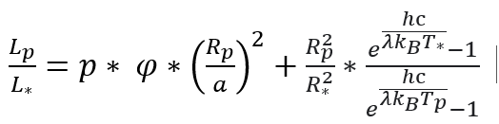

Methods: Direct Imaging
The state-of-the-art signal contrast from the TMT Second Earth Imager is a minimum of 8 * 10⁻⁸ at 0.01 arcseconds.
Notes:
Describing the equations and what they mean, what is needed for doing this method

Slide 6
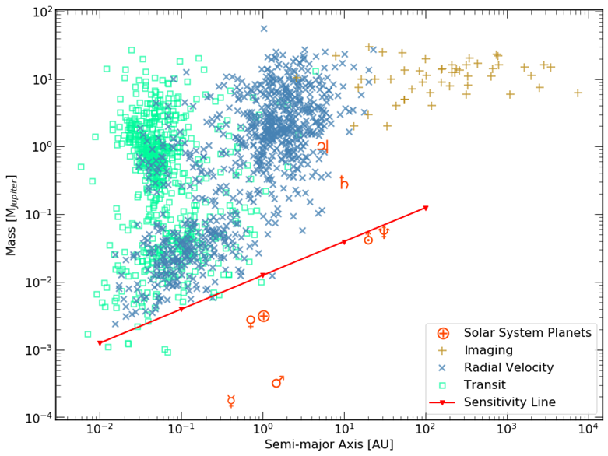
Results: Radial Velocity Method
For a Jupiter-like planet around a Sun-like star: K = 12.46 m/s
Notes:
Describing the state of the art value, how that makes this sensitivity line,
Everything above this line would therefore be able to be detected with the state of the art
Using this equation, given the assumption of a planet with the mass and semi-major axis of Jupiter around a star of 1 solar mass, that the radial velocity value determined is 12. m/s.

Slide 7
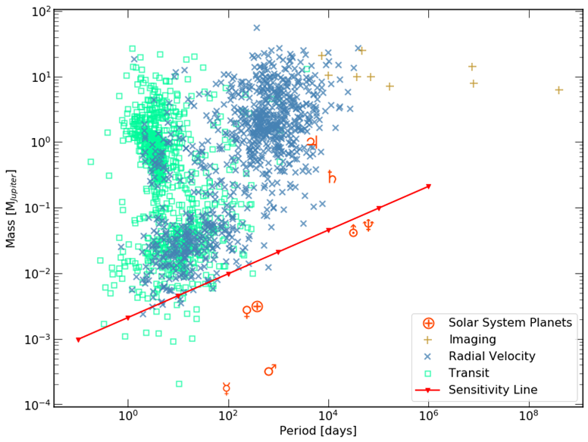

Slide 8
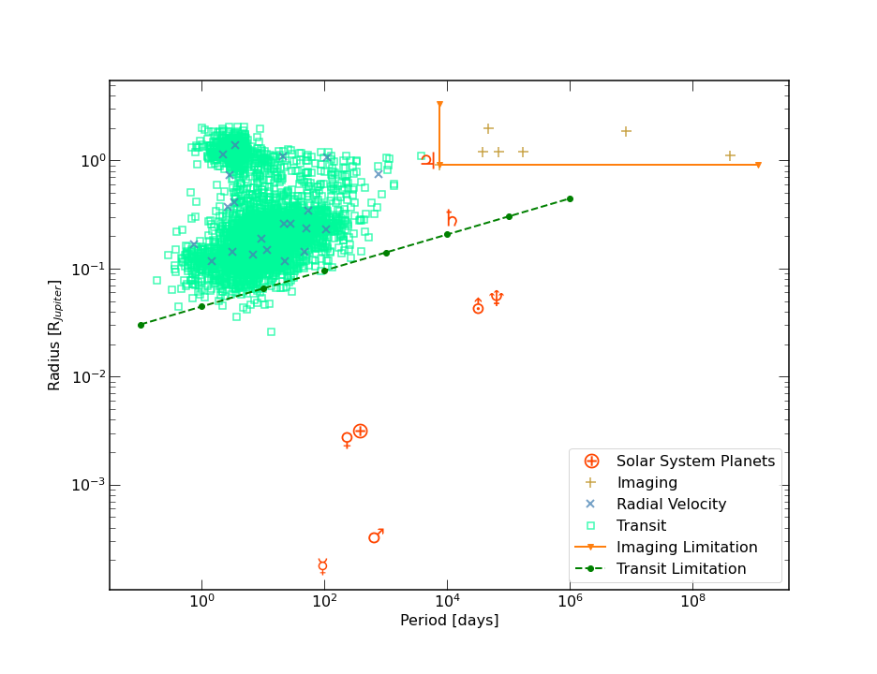
Results: Transit Method
With the state of the art sensitivity of K2 is at 12 ppm.
Able to detect a planet down to 1/30 R_{j} around a Sun-like star
SNR = 278 for a Jupiter like planet around a Sun-like star

Slide 9
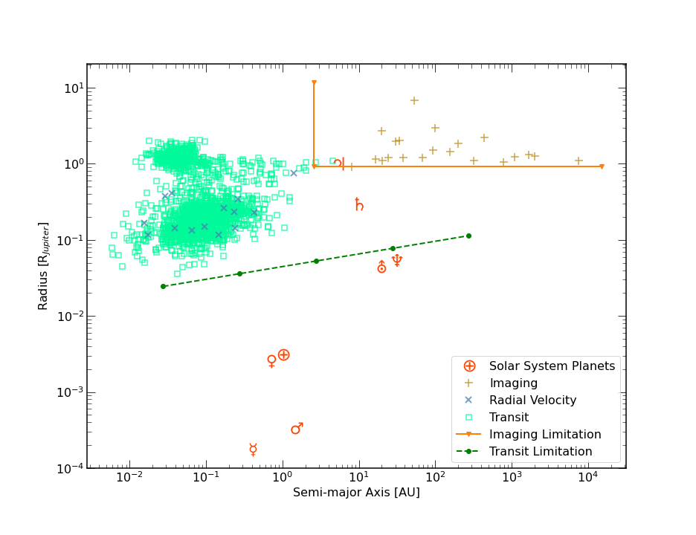

Slide 10
Results: Direct Imaging
With the assumption of a constant geometric albedo and the phase is π/2,
Jupiter’s signal at peak emission (23 microns) = 10⁻⁶ which fall within range of the Second Earth Imager instrument.

Slide 11
Conclusions
Radial velocity: Can easily detect a Jupiter-like planet
Transit: Can easily detect a Jupiter-like planet
Direct Imaging: Can only be detected out to 9pc with state-of-the art

Slide 12
Contributions
Questions?
Kevin Hoy: Analysis of Direct Imaging detection method
Joshua Kingsbury: Analysis of Transits detection method
Avidaan Srivastava: Writing of the report
Logan Steele: Analysis of Radial Velocity detection method and in-class presentation

